Slide 1



PicNix: Nixing Image Duplicates
Presented By:
Group 1
Pandre Vamshi 115077003
Prajjawal Agarwal 115134849
Shreejay V. Jahagirdar 115071683
Under Supervision:
Prof. Zhenhua Liu

Slide 2
Background
The primary crux of our project is Image Deduplication: to prevent storing multiple copies of the same image.
Initially, we focused on the celebrities and the fan pages issue on Social Media.
With a valuable feedback from Professor, we have adapted our platform to cater more comprehensively to the needs of users in the NFT (Non-Fungible Token) community.
There are already many IP (Intellectual Property) theft that take place on NFT websites. With AI image generation these numbers are prone to go higher.
By showing the similar and duplicate images through PicNix on these websites, we aim to provide a valuable and engaging space for users passionate about the visual and creative aspects of the NFT ecosystem.
This will help the artists to sell their property without fear, help the end-users buy legitimate products, and will help companies optimize their storage space. A win-win situation.

Slide 3
Technology
Frontend Framework
Queue
1
4
React
Celery and Redis
Backend Framework
Image Processing
2
5
Python Django
OpenCV
Database Management
3
SQLite

Slide 4
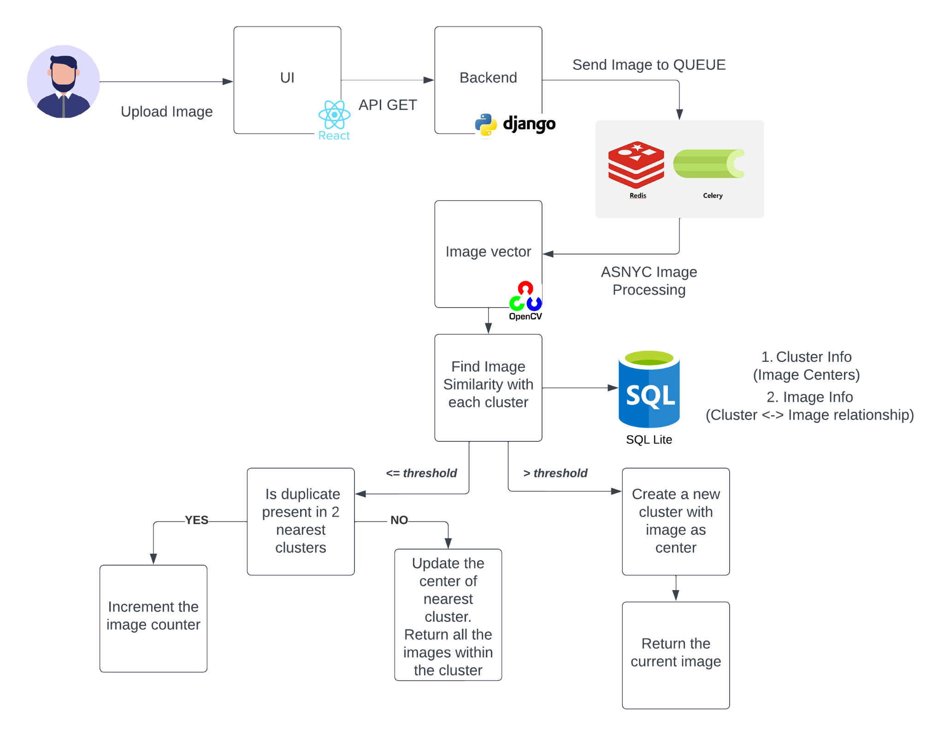
Design

Slide 5

Demo

Slide 6
Limitations
Query will not be so fast once the dataset increases, as we use SQLite with 3 table joins. Instead a NoSQL database can be used.
Presently, frontend reloading is required once the processing phase is completed. To enhance user experience and eliminate the need for reloads, consider implementing websockets.
While clustering images enhances the efficiency of our system, it's important to note that the process is not infallible, and occasional inaccuracies may arise due to the inherent complexity and diversity of image content.

Slide 7
Future Works
To optimize the scalability and performance of the system which may involve fine-tuning database queries and adopting caching strategies.
Investigate advanced clustering algorithms to mitigate occasional inaccuracies, addressing the challenges posed by diverse image content and further refining the precision of similarity groupings.
Implementing a system for derivative images which can optimize storage by indicating modifications, allowing the organization to efficiently manage variations of an original image.

Slide 8
References
[1] A. K. Layek, A. Gupta, S. Ghosh and S. Mandal, "Fast near-duplicate detection from image streams on online social media during disaster events," 2016
Research Paper Link: https://ieeexplore.ieee.org/abstract/document/7839137

Slide 9
Thank you!

